Slide 1

Spring of Code
Artificial Intelligence
(Machine Learning & Deep Learning)
Instructor
Asad Ullah
- Research Assistant (DIP Lab)
Duration
03 Months
(Feb – April)

Slide 2
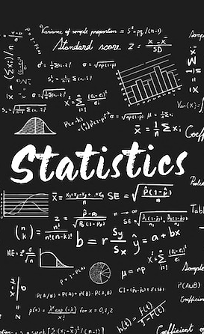
Day 01 – Descriptive Statistics
(Correlation)
Objectives:
What is Correlation?
Correlation Coefficient
Univariate, Bivariate, and Multivariate Plots
Introduction to Probability

Slide 3
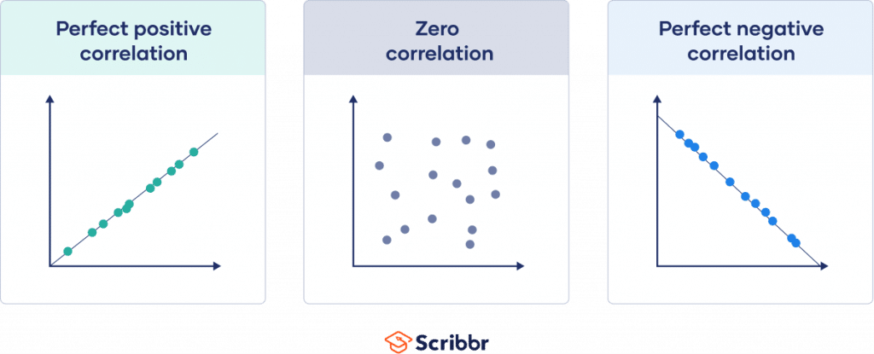
Correlation
A statistical measure that describes the strength and direction of the relationship between two variables, showing how they tend to change together.
It's quantified by a correlation coefficient.
Correlation may be positive, zero, or negative.

Slide 4
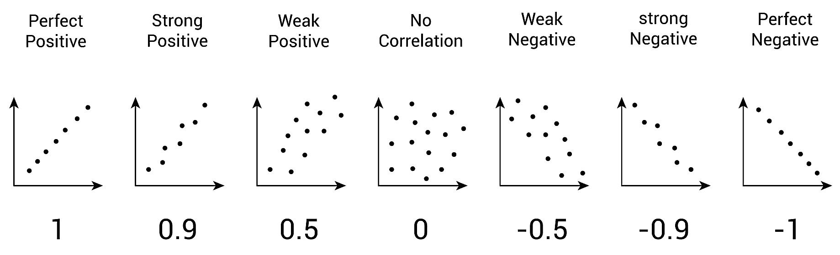
Correlation Coefficient
A correlation coefficient is a number between -1 and 1 that tells you the strength and direction of a relationship between variables.

Slide 5
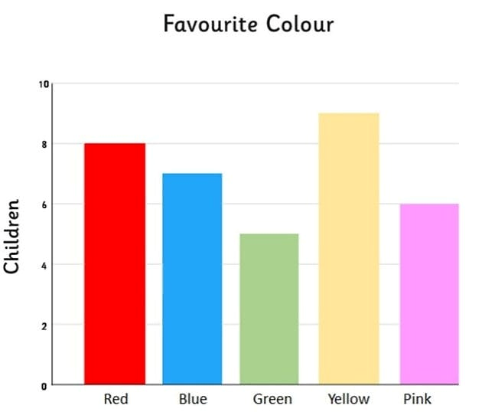
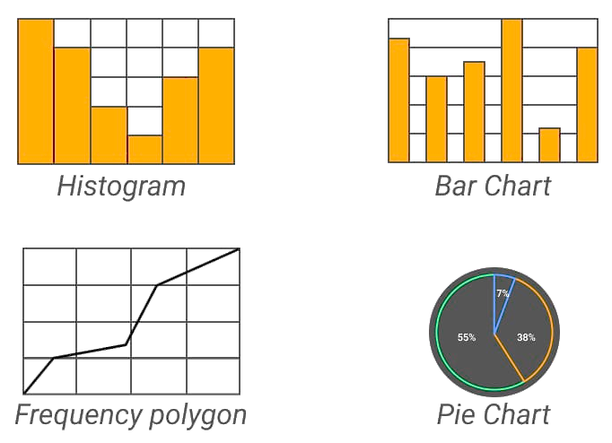
Univariate Data
It consists of observations for a single characteristic or variable, used to describe and summarize its distribution, central tendency, and variability.
Data can be displayed using frequency polygon, histograms, stem and leaf plots, box and whisker plots, or pie charts.

Slide 6
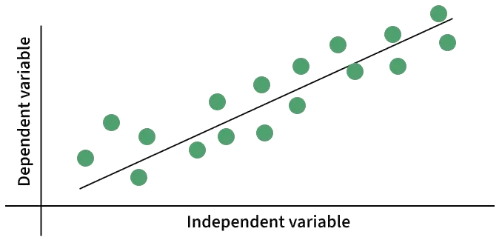
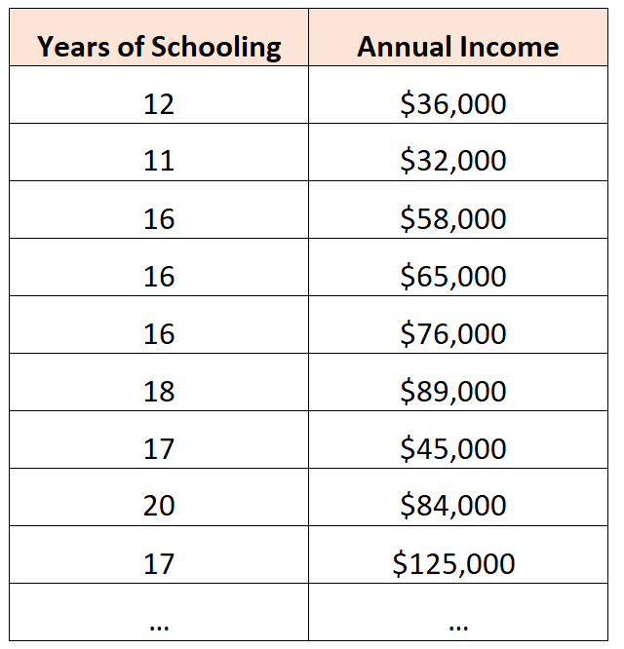
Bivariate Data
Scatterplot
It consists of two variables where each data point has a value for both, used to analyze the relationship between them.
Often analyzed using a scatterplot, where one variable is plotted on the x-axis and the other on the y-axis.
Each data point represents two pieces of information.

Slide 7
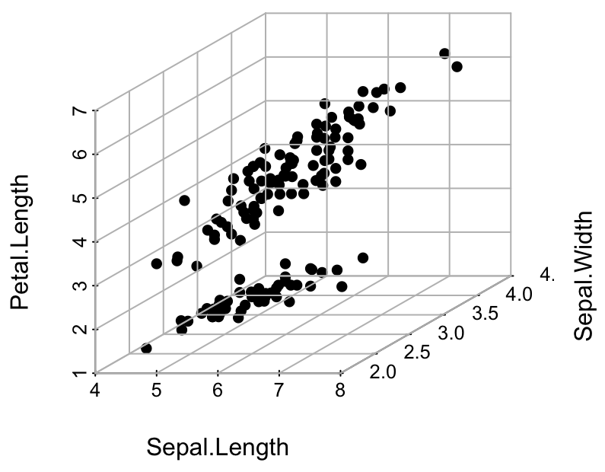
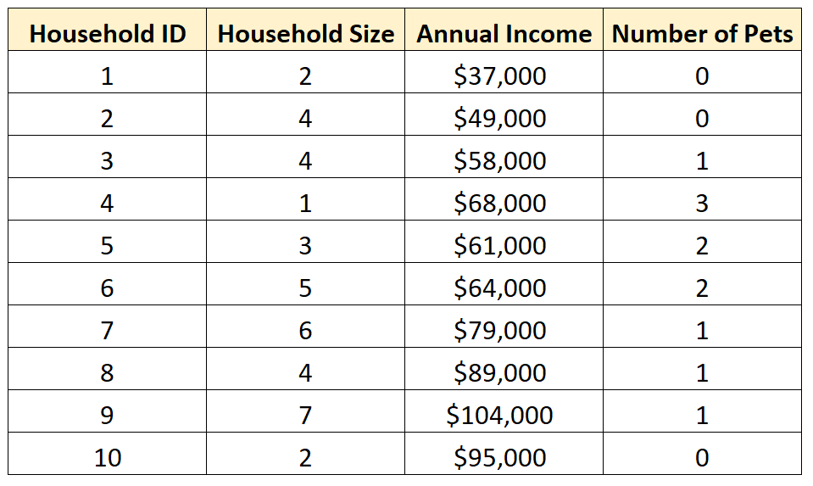
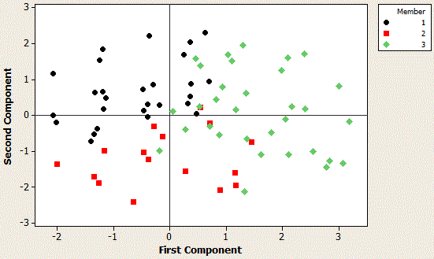
Multivariate Data
Scatterplot
It consists of observations for two or more variables for each unit in a dataset, such as a person's age, weight, and blood pressure.

Slide 8
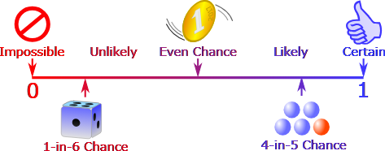
Probability
Probability is the measure of how likely an event is to occur.
It is expressed as a number between 0 and 1, or 0% and 100%.
Formula for probability of single event:
P(E) = number of ways event can happen / number of possible events

Slide 9
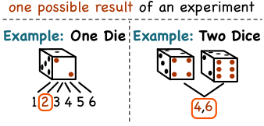
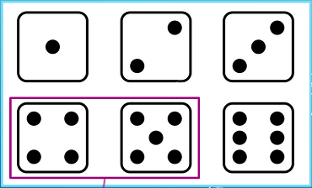
Sample Space and Events
Sample space (S) is the complete set of all possible outcomes for a random experiment.
An event is a specific subset of the sample space, representing one or more of those possible outcomes
Event
Sample Space

Slide 10

Thank You

